Slide 1

TITLE: BIKE SHARING PREDICTION

Slide 2
NAME : B.JAHNAVI
HT.NO : 2203A52142
Under the guidance
MR .D .RAMESH
Asst .Prof
CS&AI

Slide 3

PROBLEM STATEMENT
The problem statement for a bike-sharing prediction typically involves predicting bike rental demand based on various factors?

Slide 4
INTRODUCTION
Bike sharing systems are new generation of traditional bike rentals where whole process from membership, rental and return back has become automatic. Through these systems, user is able to easily rent a bike from a particular position and return back at another position. Currently, there are about over 500 bike-sharing programs around the world which is composed of over 500 thousands bicycles. Today, there exists great interest in these systems due to their important role in traffic, environmental and health issues.
Apart from interesting real world applications of bike sharing systems, the characteristics of data being generated by these systems make them attractive for the research. Opposed to other transport services such as bus or subway, the duration of travel, departure and arrival position is explicitly recorded in these systems. This feature turns bike sharing system into a virtual sensor network that can be used for sensing mobility in the city. Hence, it is expected that most of important events in the city could be detected via monitoring these data.

Slide 5
ATTRIBUTE INFORMATION: Both hour.csv and day.csv have the following fields, except hour which is not available in day.csv instant: record index date day : date season : season (1:springer, 2:summer, 3:fall, 4:winter) year : year (0: 2011, 1:2012) month : month ( 1 to 12) hour : hour (0 to 23) holiday : weather day is holiday or not (extracted from [Web Link]) weekday : day of the week working day : if day is neither weekend nor holiday is 1, otherwise is 0.

Slide 6
Data set:
season | year | month | hr | holiday | weekday | workingday | weathersit | temp
1 | 0 | 1 | 0 | 0 | 6 | 0 | 1 | 0.24
1 | 0 | 1 | 1 | 0 | 6 | 0 | 1 | 0.22
1 | 0 | 1 | 2 | 0 | 6 | 0 | 1 | 0.22
1 | 0 | 1 | 3 | 0 | 6 | 0 | 1 | 0.24
1 | 0 | 1 | 4 | 0 | 6 | 0 | 1 | 0.24
1 | 0 | 1 | 5 | 0 | 6 | 0 | 2 | 0.24
1 | 0 | 1 | 6 | 0 | 6 | 0 | 1 | 0.22
1 | 0 | 1 | 7 | 0 | 6 | 0 | 1 | 0.2
1 | 0 | 1 | 8 | 0 | 6 | 0 | 1 | 0.24
1 | 0 | 1 | 9 | 0 | 6 | 0 | 1 | 0.32
1 | 0 | 1 | 10 | 0 | 6 | 0 | 1 | 0.38
1 | 0 | 1 | 11 | 0 | 6 | 0 | 1 | 0.36
1 | 0 | 1 | 12 | 0 | 6 | 0 | 1 | 0.42
1 | 0 | 1 | 13 | 0 | 6 | 0 | 2 | 0.46
1 | 0 | 1 | 14 | 0 | 6 | 0 | 2 | 0.46

Slide 7
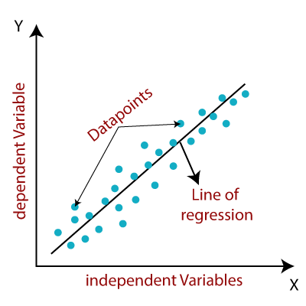
LINEAR REGRESSION:
Linear regression analysis is used to predict the value of a variable based on the value of another variable. The variable you want to predict is called the dependent variable. The variable you are using to predict the other variable's value is called the independent variable.

Slide 8
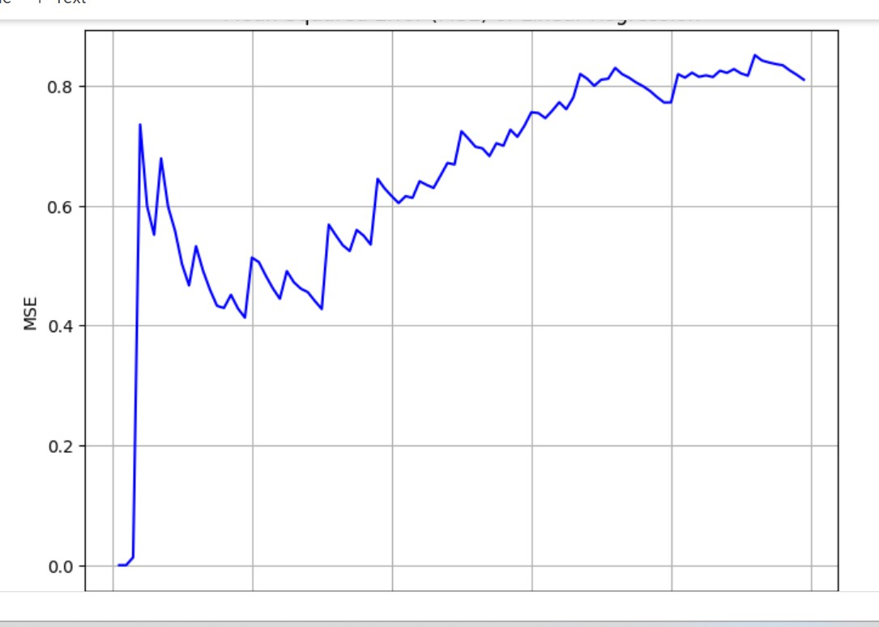
LINEAR REGRESSION VALUES OF MY PROJECT:
MSE(Mean square error):0.4327459452641531
RELATED GRAPH:

Slide 9
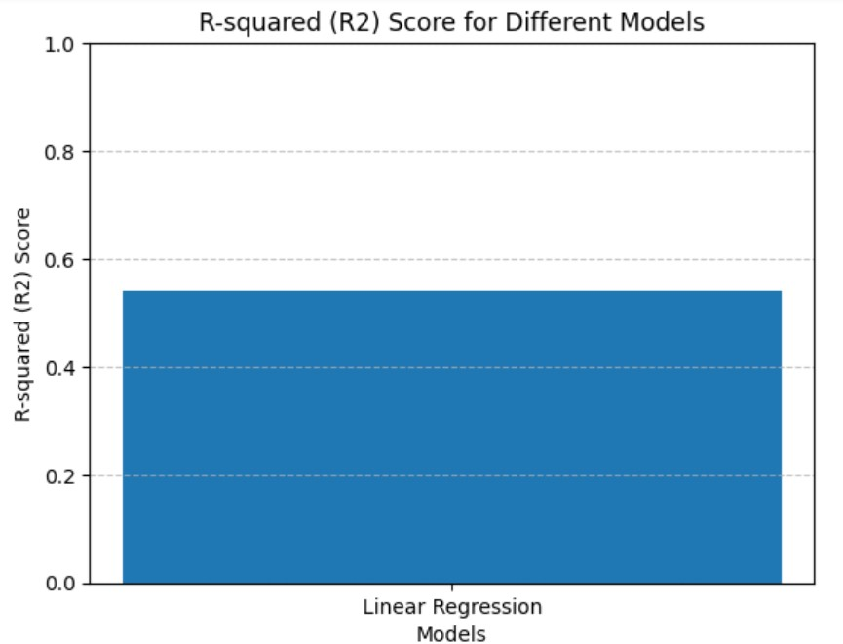
LINEAR REGRESSION VALUES OF MY PROJECT:
R2 SCORE:0.4416734154281159
RELATED GRAPH:

Slide 10
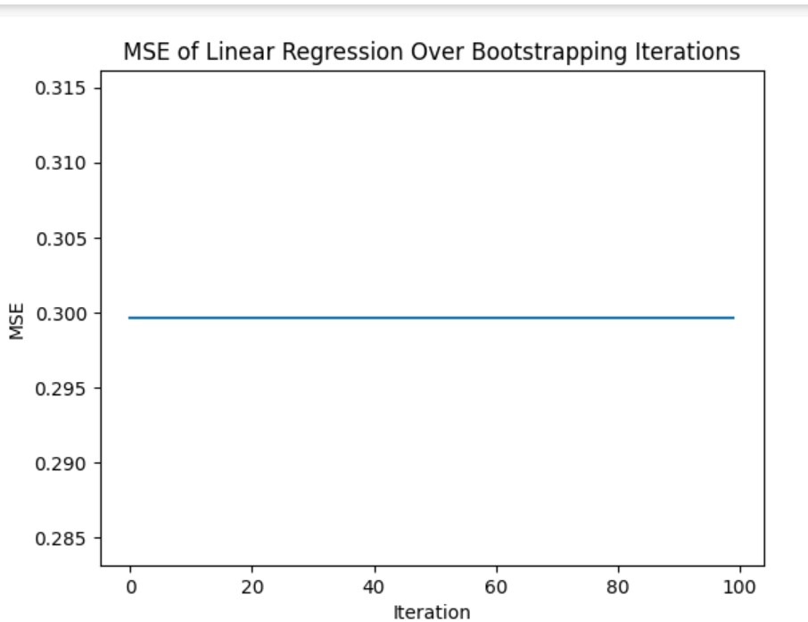
APPLYING BOOTSRAPPING FOR MY PROJECT:
MSE for linear Regression over bootstrapping:
Value of MSE: 0.29963967895119775
RELATED GRAPH:
R2 score for Linear Regression over bootstrapping:0.38076453995817156

Slide 11
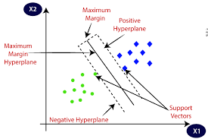
SVM(SUPPORT VECTOR MACHINE): Support Vector Machine (SVM) is a powerful machine learning algorithm used for linear or nonlinear classification, regression, and even outlier detection tasks. SVMs can be used for a variety of tasks, such as text classification, image classification, spam detection, handwriting identification, gene expression analysis, face detection, and anomaly detection. SVMs are adaptable and efficient in a variety of applications because they can manage high-dimensional data and nonlinear relationships.

Slide 12
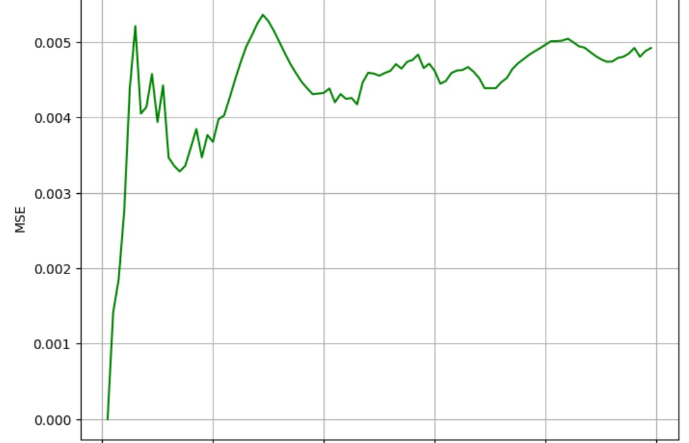
SVM VALUES OF MY PROJECT:
MSE(Mean square error):0.006790699748349241
RELATED GRAPH:

Slide 13
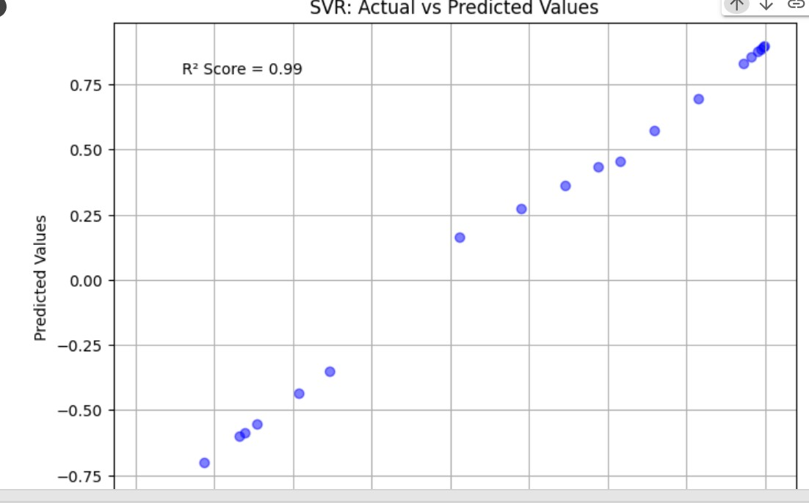
SVM VALUES OF MY PROJECT:
R2 score for SVM: 0.985966337644622
RELATED GRAPH:

Slide 14
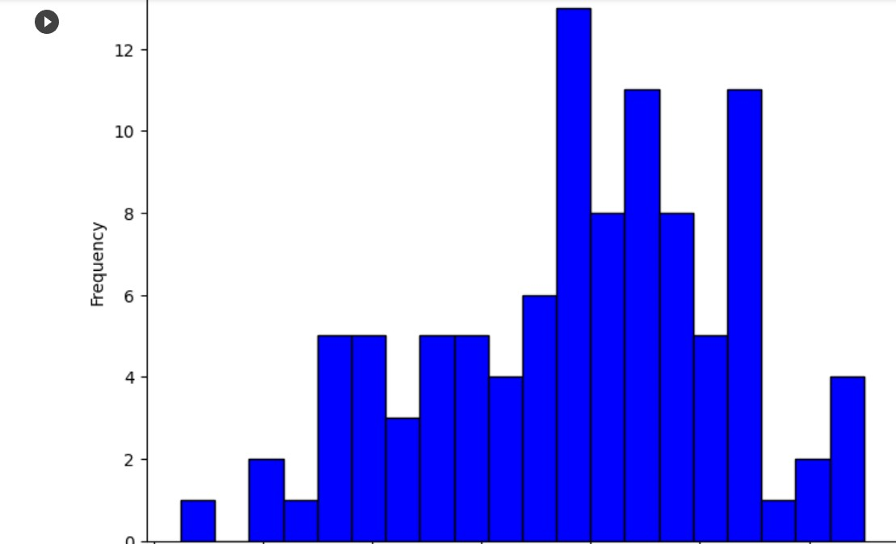
APPLYING BOOTSRAPPING FOR MY PROJECT
MSE(Mean square error):0.006790699748349241
RELATED GRAPH:

Slide 15
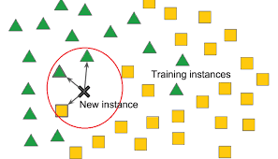
KNN (K NEAREST NEIGHBOURS):
K-Nearest Neighbors (KNN) is a machine learning algorithm used for both classification and regression tasks. It makes predictions based on the majority class or average value of the K-nearest data points in a feature space. KNN works by measuring distances between data points and selecting the K-nearest neighbors to make predictions. The choice of K can impact the algorithm’s performance, and it is a simple but often effective approach for various tasks.

Slide 16
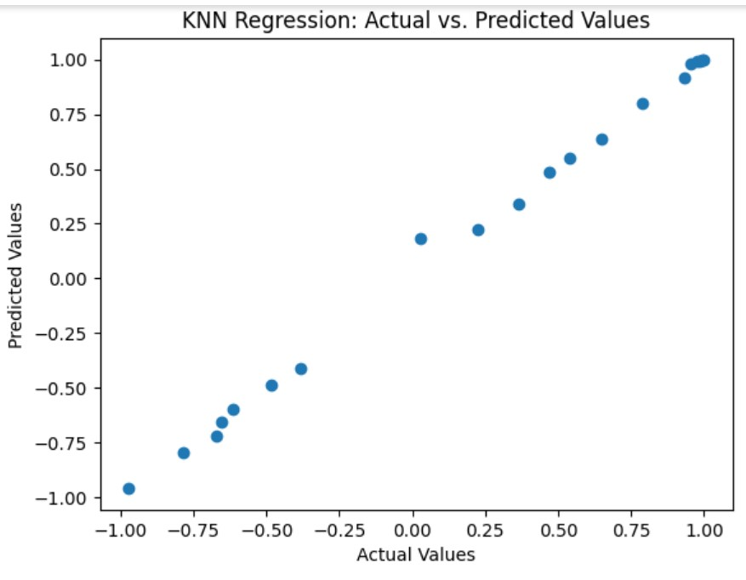
KNN VALUES OF MY PROJECT:
MSE FOR KNN: 0.0015105521909583972

Slide 17
KNN VALUES OF MY PROJECT:
K=1, R-squared Score: 0.9988
K=2, R-squared Score: 0.9985
K=3, R-squared Score: 0.9976
K=4, R-squared Score: 0.9975
K=5, R-squared Score: 0.9969
K=6, R-squared Score: 0.9960
K=7, R-squared Score: 0.9957
K=8, R-squared Score: 0.9944
K=9, R-squared Score: 0.9938
K=10, R-squared Score: 0.9922
K=11, R-squared Score: 0.9900
K=12, R-squared Score: 0.9884
K=13, R-squared Score: 0.9861
K=14, R-squared Score: 0.9831
K=15, R-squared Score: 0.9807
K=16, R-squared Score: 0.9774
K=17, R-squared Score: 0.9734
K=18, R-squared Score: 0.9691

Slide 18
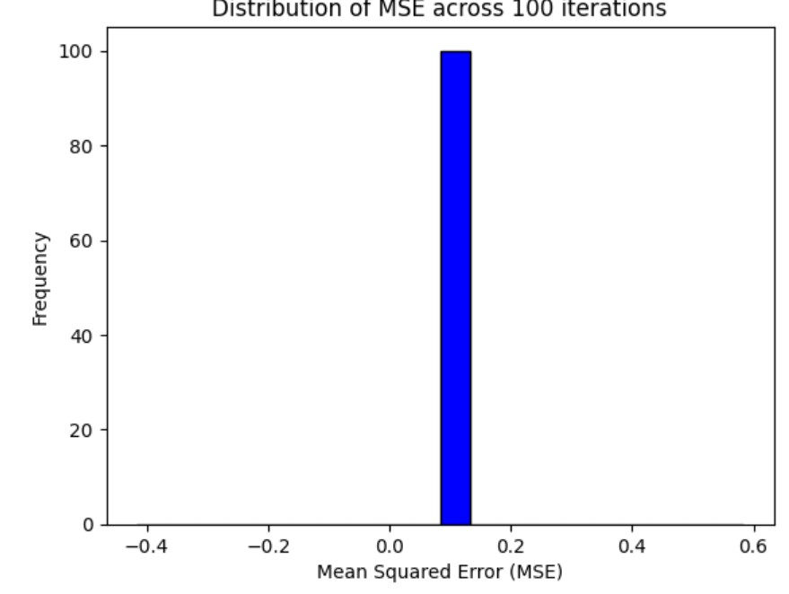
APPLYING BOOTSRAPPING FOR MY PROJECT:
MSE VALUE: 0.08347223157499661

Slide 19
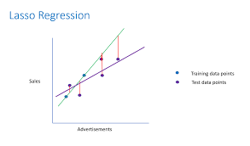
LASSO REGRESSION:
Lasso regression is a regularization technique. It is used over regression methods for a more accurate prediction. This model uses shrinkage. Shrinkage is where data values are shrunk towards a central point as the mean. The lasso procedure encourages simple, sparse models (i.e. models with fewer parameters).

Slide 20
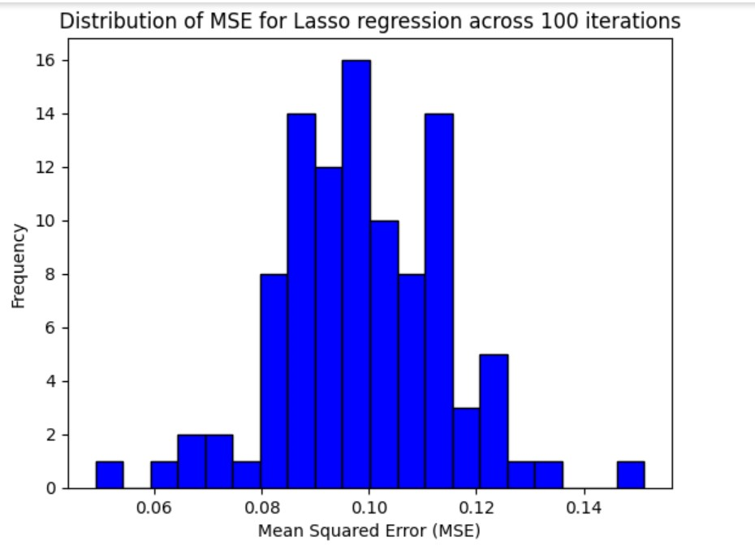
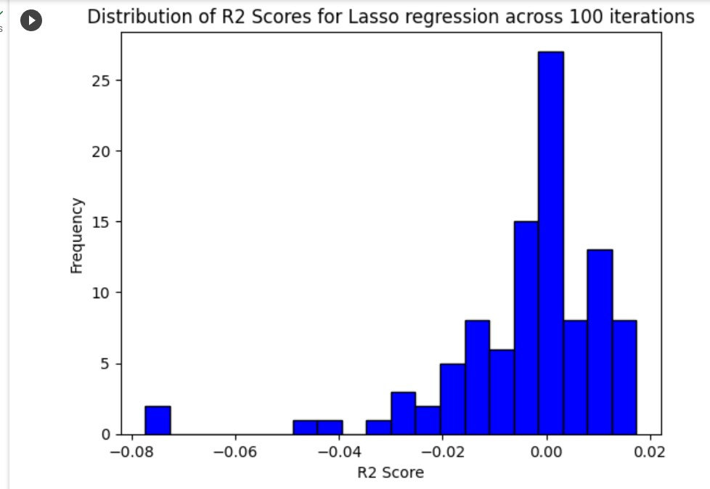
LASSO VALUES OF MY PROJECT:
MSE for lasso: 0.18322771333926646
R2 score for lasso: -0.07183392471590105

Slide 21
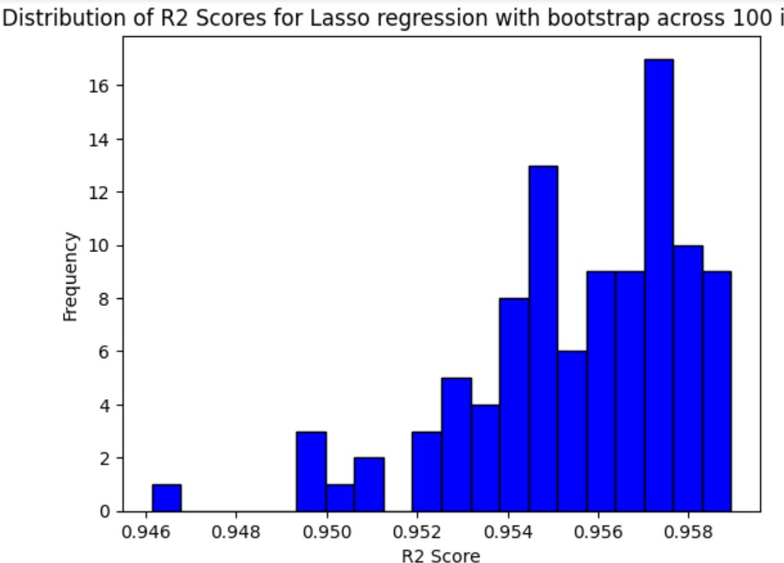
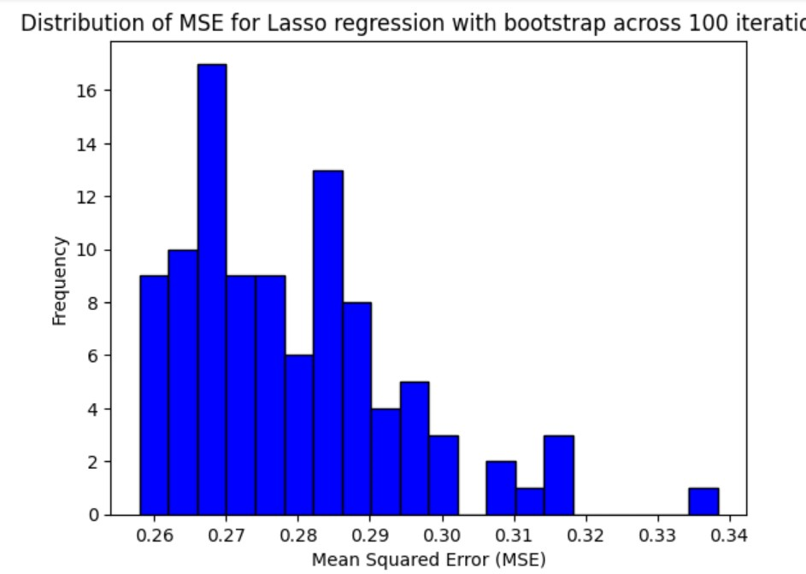
APPLYING BOOTSRAPPING FOR MY PROJECT:
R2 score for bootstrapping: 0.9555692558936911
MSE for bootstrapping: 0.27912524382623877

Slide 22
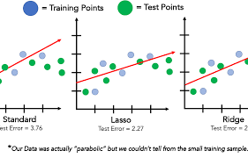
RIDGE REGRESSION:
Ridge regression is a model tuning method that is used to analyse any data that suffers from multicollinearity. This method performs L2 regularization. When the issue of multicollinearity occurs, least-squares are unbiased, and variances are large, this results in predicted values being far away from the actual values.

Slide 23
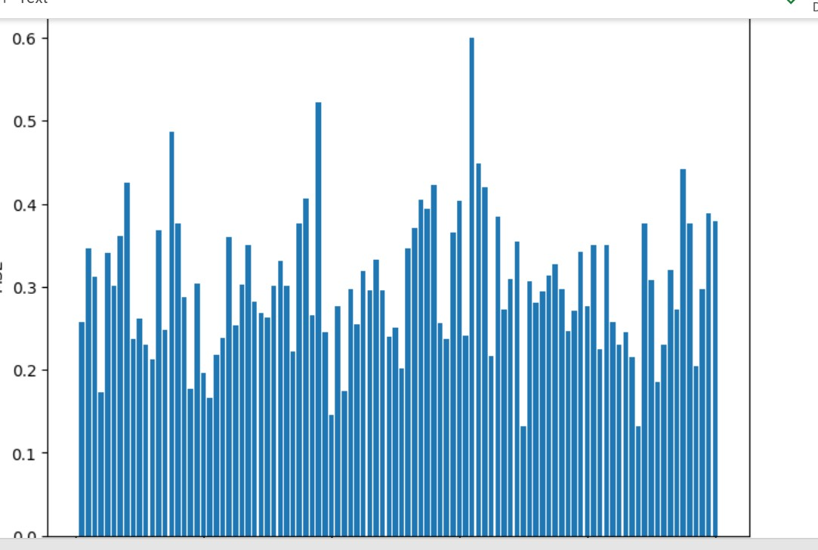
RIDGE VALUES OF MY PROJECT:
MSE for ridge regression: 0.19197890198752035
RELATED GRAPH:

Slide 24
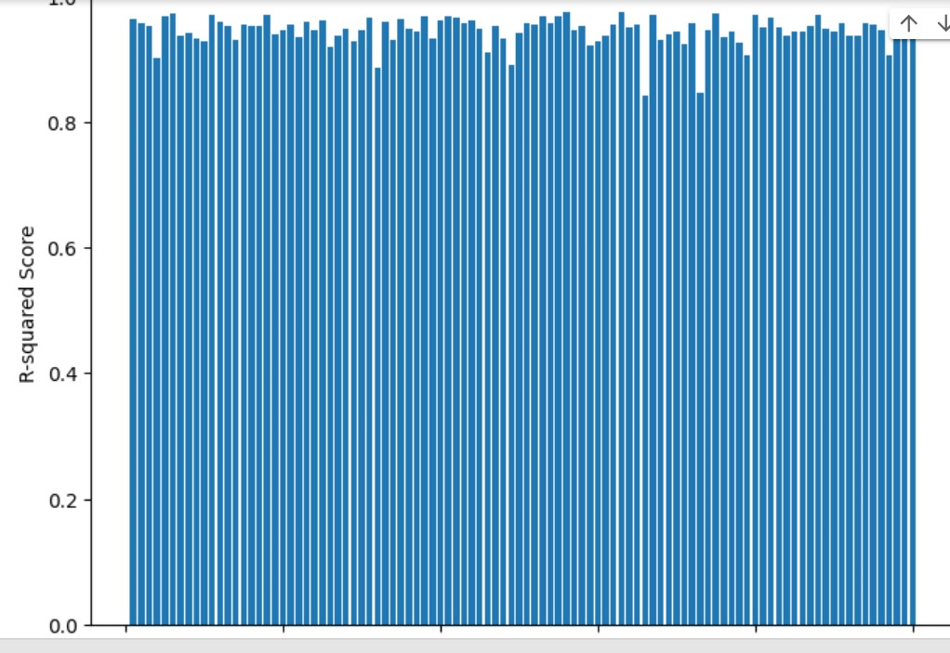
RIDGE VALUES OF MY PROJECT:
R2 score for ridge: 0.9455218032375126
RELATED GRAPH:

Slide 25
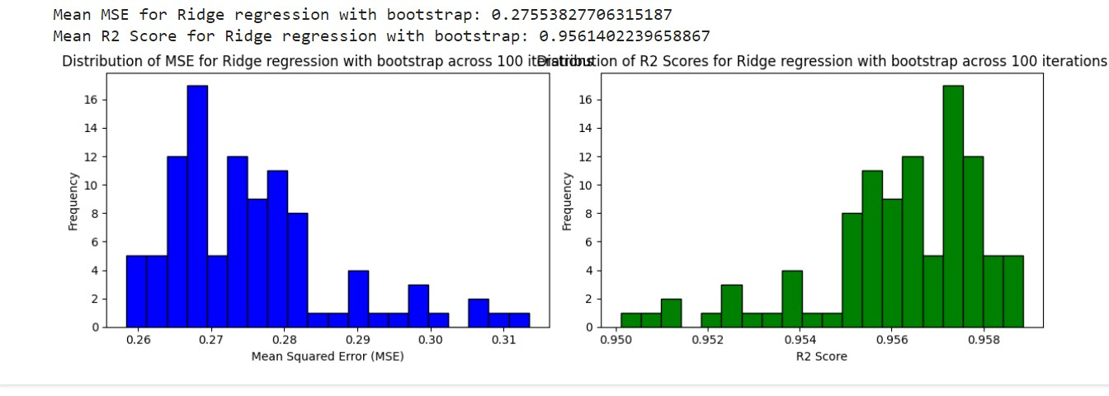
APPLYING BOOTSRAPPING FOR MY PROJECT:
RELATED GRAPH:

Slide 26
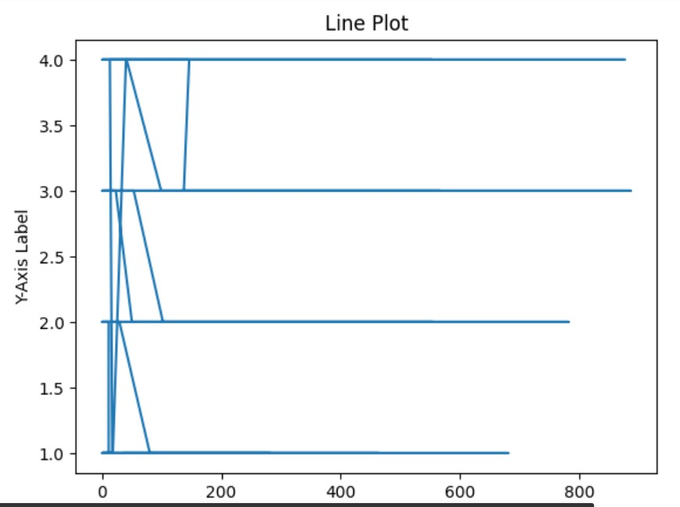
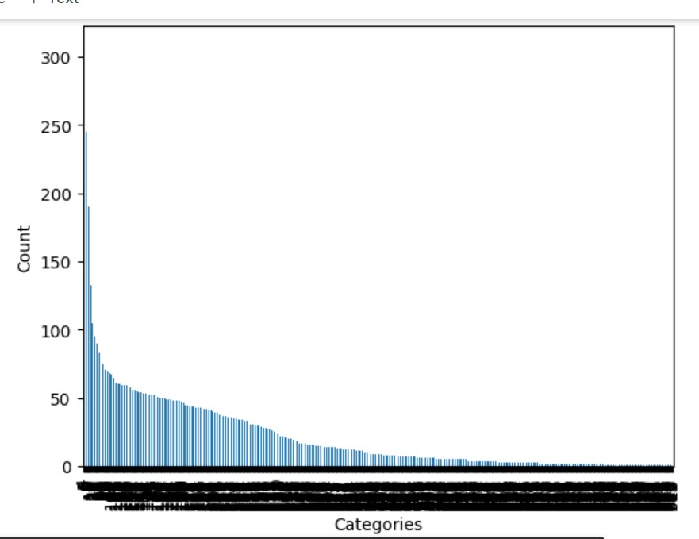
GRAPHS:

Slide 27
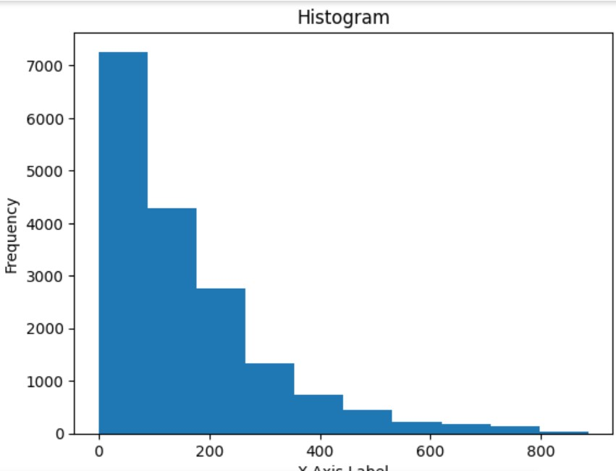
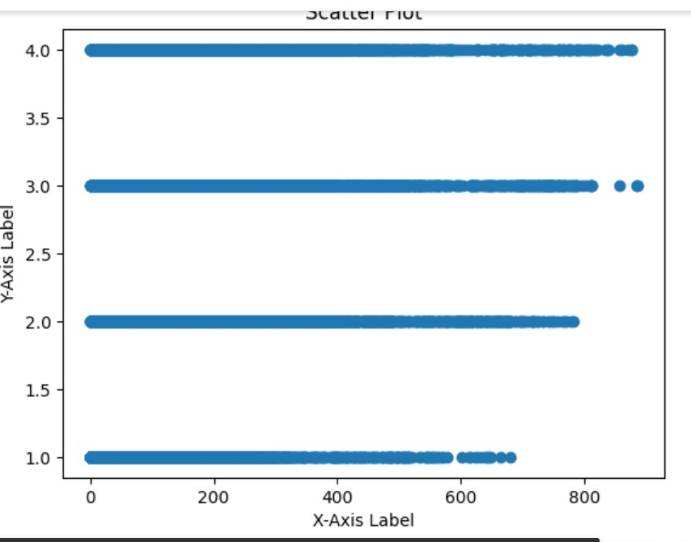
GRAPHS

Slide 28
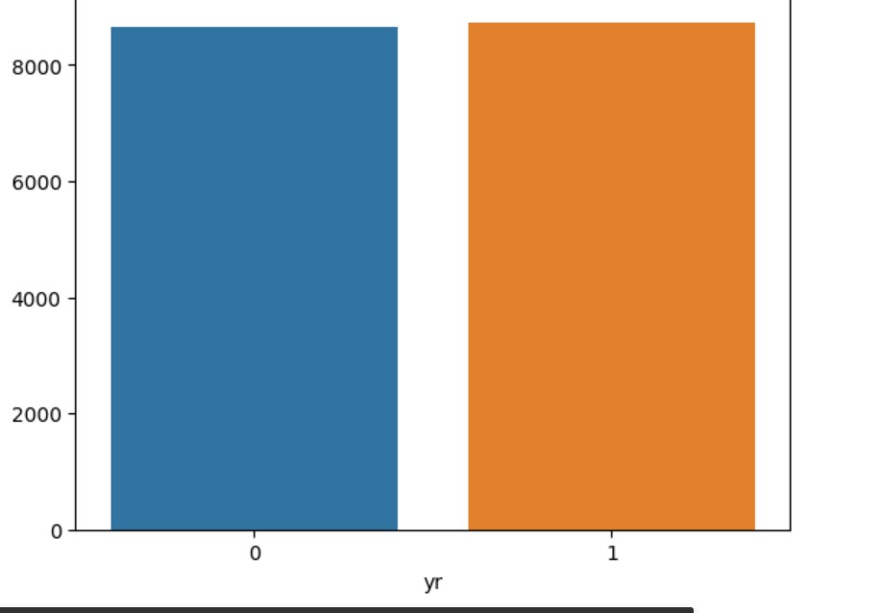
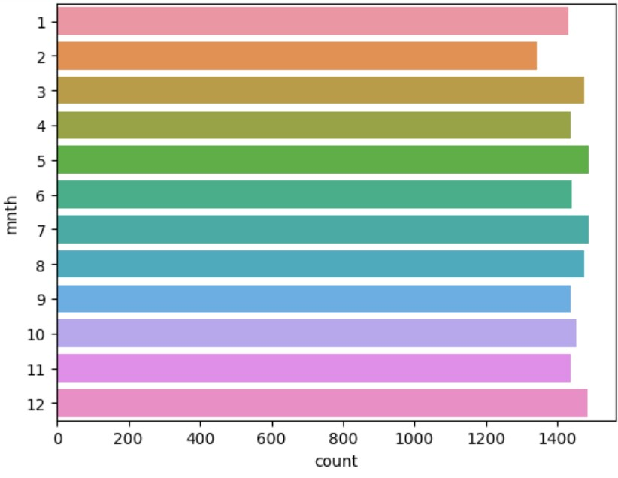
GRAPHS

Slide 29
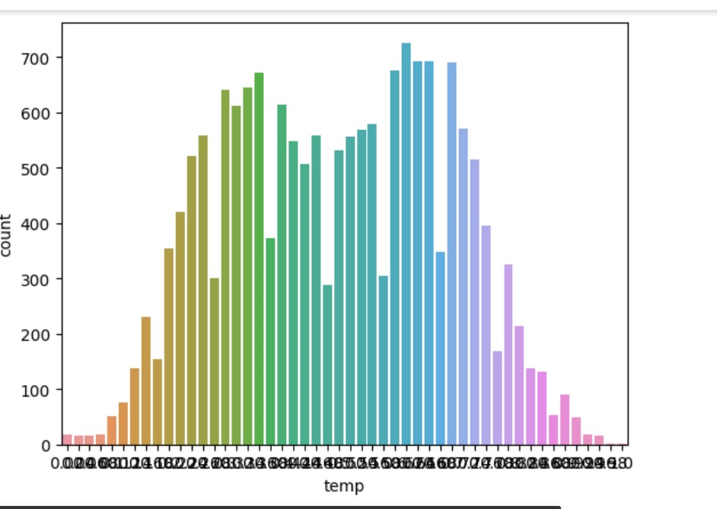
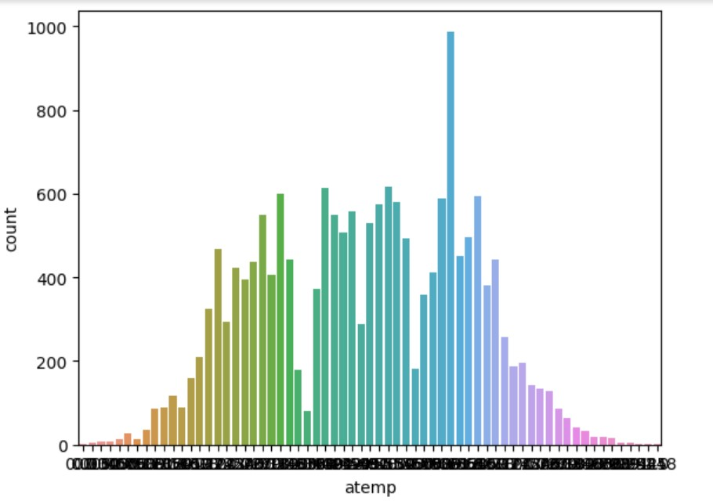
GRAPHS

Slide 30
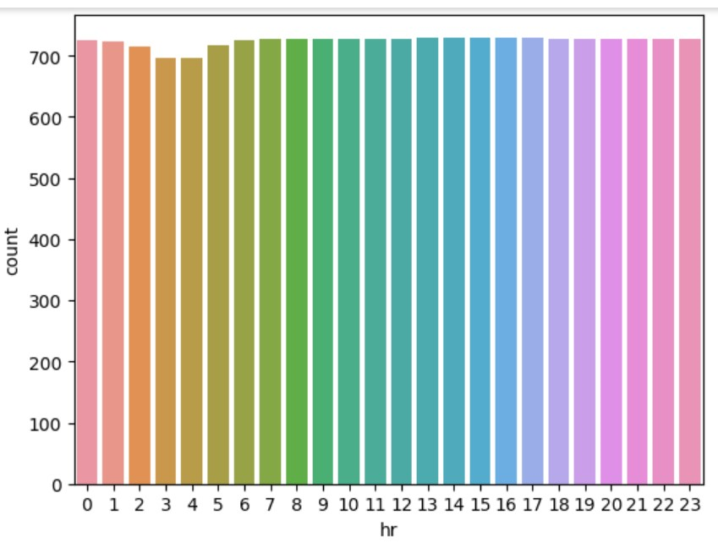
GRAPHS

Slide 31
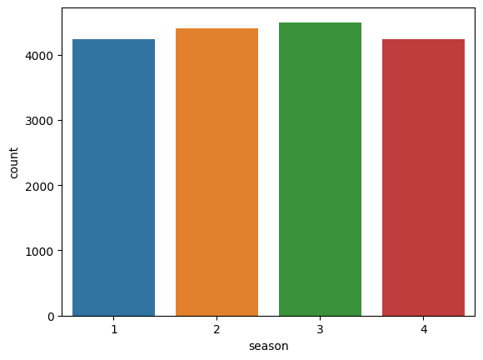
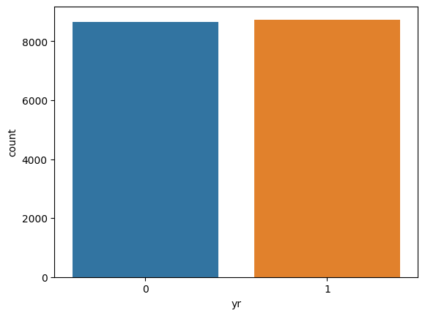

Slide 32
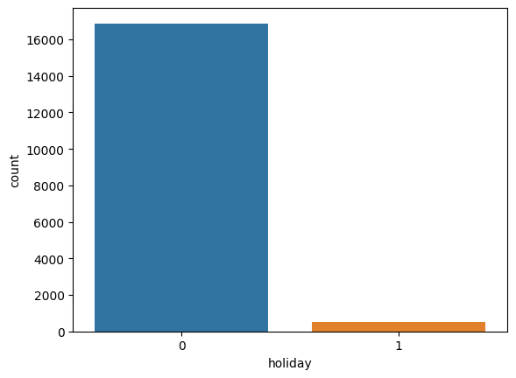
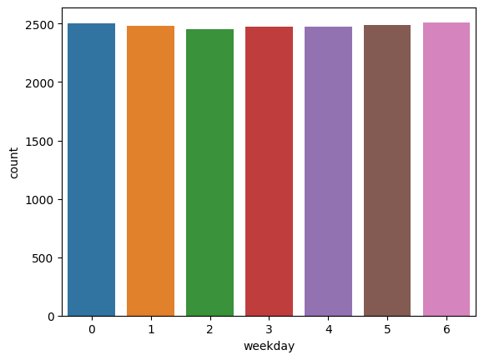
GRAPHS:

Slide 33
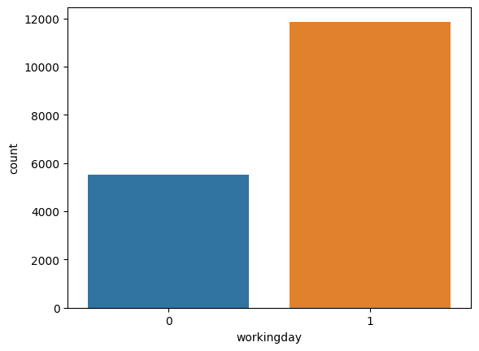
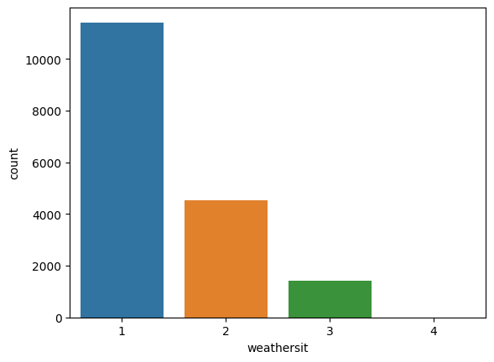
GRAPHS:

Slide 34
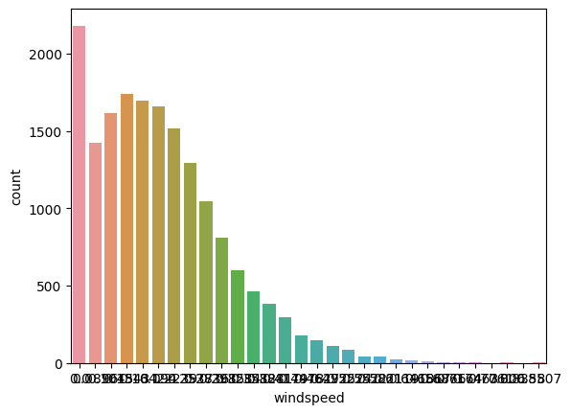
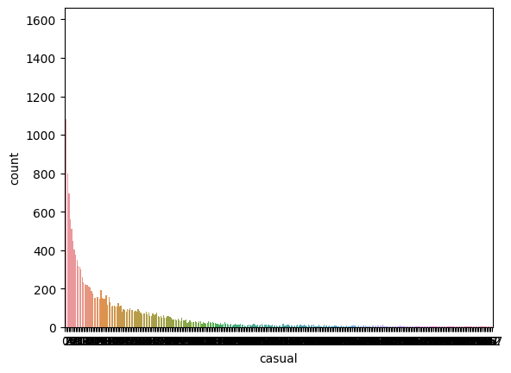
GRAPHS:

Slide 35
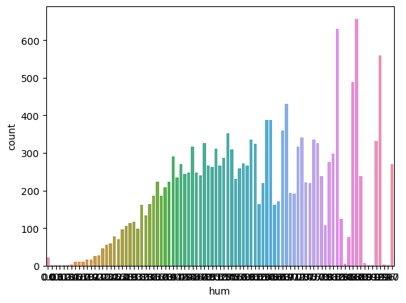
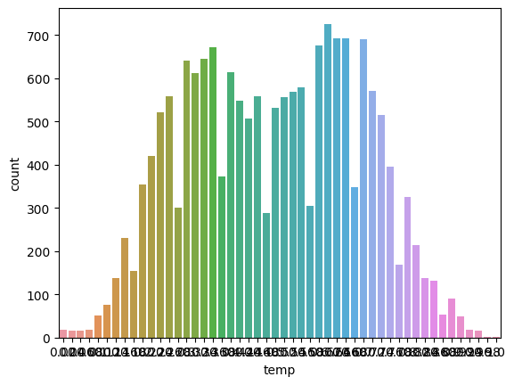
GRAPHS:

Slide 36
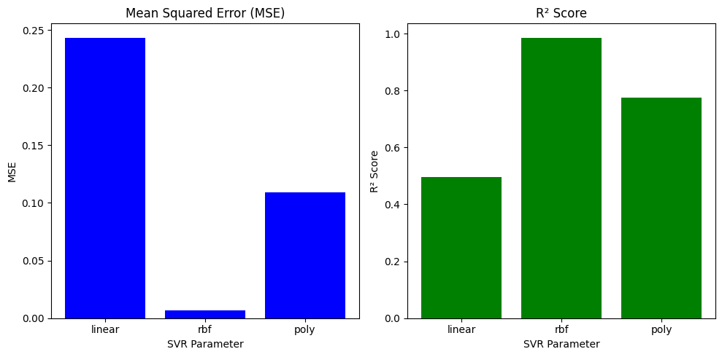
GRAPH BETWEEN MSE AND R2 SCORE:

Slide 37
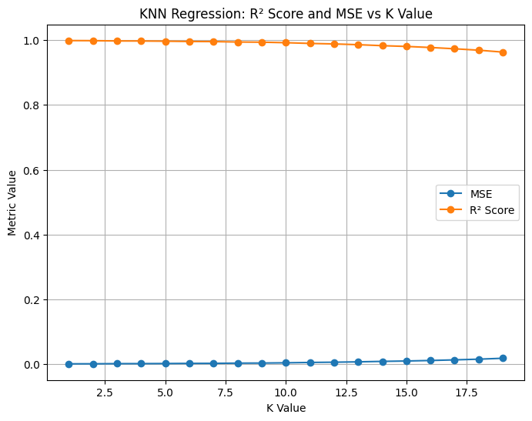
GRAPH FOR KNN MSE VS R2 SCORE:

Slide 38
CONCLUSION: In conclusion, this bike sharing project has provided valuable insights into the dynamics of urban transportation and sustainability. The data analysis revealed a clear increase in bike usage, indicating a growing interest in eco-friendly commuting options. Seasonal patterns demonstrated that spring and summer months witness higher bike rentals, underscoring the importance of adapting resources to meet fluctuating demand. Moreover, the project highlighted the significant impact of weather conditions on bike rentals, offering operational opportunities for optimizing user experiences and resource allocation. GITHUB LINK: https://github.com/Jahnavi4boddepalli/Bike-sharing-prediction.git
In conclusion, this bike sharing project has provided valuable insights into the dynamics of urban transportation and sustainability. The data analysis revealed a clear increase in bike usage, indicating a growing interest in eco-friendly commuting options. Seasonal patterns demonstrated that spring and summer months witness higher bike rentals, underscoring the importance of adapting resources to meet fluctuating demand. Moreover, the project highlighted the significant impact of weather conditions on bike rentals, offering operational opportunities for optimizing user experiences and resource allocation. The development of predictive models showcased the potential for accurate demand forecasting, contributing to the efficient management of bike sharing systems. Looking ahead, opportunities for expansion, integration with other public transportation modes, and sustainability initiatives were identified as key areas to further enhance the bike sharing experience and promote sustainable urban mobility. This project lays a solid foundation for future research and actions aimed at improving bike sharing systems and their contributions to more eco-friendly and accessible cities.

Slide 39
GITHUB LINK:
https://github.com/Jahnavi4boddepalli/Bike-sharing-prediction.git

Slide 40
THANK YOU

